Slide 1
AIRBNB PRICE PREDICTION

Slide 2
DATA DESCRIPTION
The dataset which we are using for the project is secondhand data, from Kaggle.com.
The dataset is Airbnb price prediction (https://www.kaggle.com/stevezhenghp/airbnb-price-prediction) and it is freely available for public use.
The data set contains 29 columns and 74112 rows.
AIRBNB is the most trending hotels in United States, concept of Airbnb is providing home like residence for the customers.
In this data set we have 29 variables which contains both numeric and categorial values, there are some variables which are not necessary for our prediction.
Variables such as price, bedrooms, accommodation, beds, bathrooms, number of reviews, review scores rating are numeric variables remain all variables are categoric.
There are some variables which can be eliminated such as host_has_profile_pic, host_since, last review, first review, neighborhood, host identity, cancellation, host response, latitude, longitude, thumbnail_url, zip code because these variables will not affect the price. 17 independent variables are mainly used to predict the price, there are no missing values in the data.

Slide 3


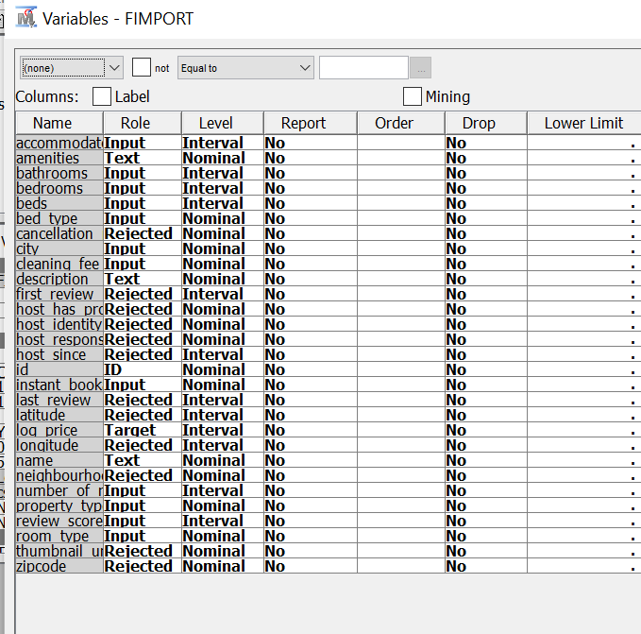
DATA SET VARIABLES:

Slide 4
DATA ASSUMPTIONS
The price value in the data is the dependent variable and it is given in logarithmic value which will make our predictions easy, using these variables we can predicted the growth rate of AIRBNB across united states, and we can also predict the price value of the Airbnb on basis of variables in the dataset.

Slide 5
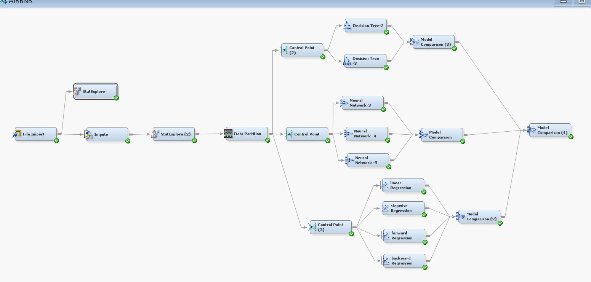
Model Diagram Using SAS Enterprise Miner:

Slide 6
PROCEDURE
STEP-1 : IMPORT NODE
External files are imported into the SAS diagram with the help of ImportNode.
Import data file into the file import node:
After inserting the data click on edit variables and for all the variables which has to be eliminated select rejected in role section.

Slide 7
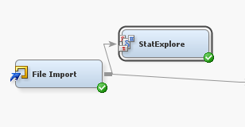
STEP-2: Statexplore node:
The StatExplore node is a multipurpose tool that you use to examine variable distributions and statistics in your data sets.
we can use StatExplore node :
To select variable for analysis, for profiling clusters, and for predictive models.
To Compute standard univariate distribution statistics.
To Compute standard bivariate statistics by class target and class segment.
Connect statexplore node to file import node and run the statexplore node and open results.
The variables in the data set are divided into two categories

Slide 8
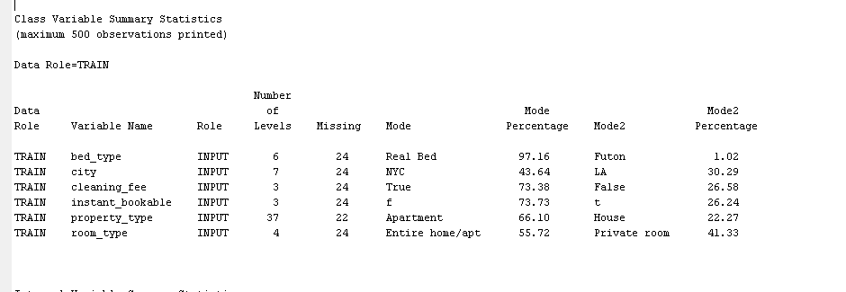
1.Class Variables: Variables which can be defined at any level and always have only one value are called class variables.

Slide 9
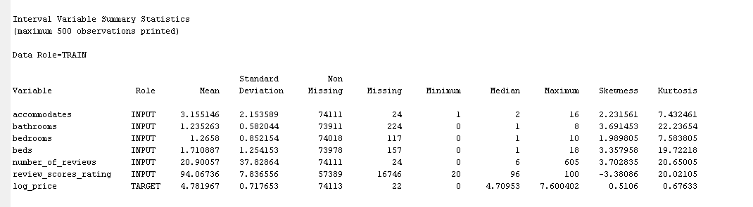
2.Interval variables:
Variables which have equal difference between two values are called interval variables.
From the results we identify the number of missing values in class variables and interval variables, to eliminate these missing values we will use impute node.

Slide 10
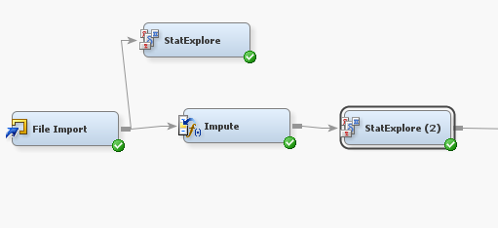
STEP:3 Impute node:
Impute node is used to replace missing values in data sets that are used for data mining.
The Impute node is typically used during the modification phase of the Sample, Explore, Modify, Model, and Assess (SEMMA) SAS data mining methodology
Without eliminating missing values there will be errors in the results, customer service glitches.
We use mean method in the imputation process, it gives mean value for all the missing values.
We attach impute node to file import node and run impute node, after that attach statExplore node to impute node and run statExplore node.

Slide 11
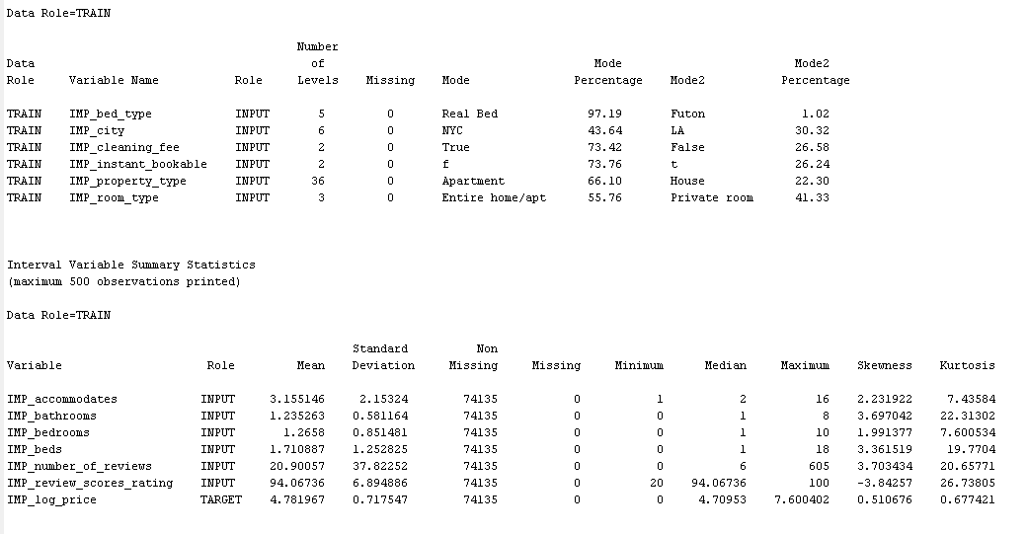
From result, we can observe all the missing values are removed and data set is ready for modeling.

Slide 12
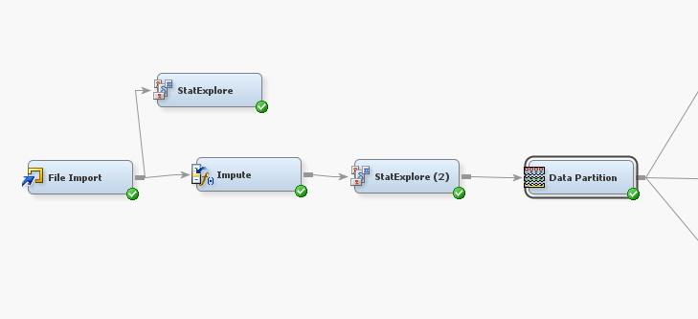
Step 4: Data Partition node:
For assessing the quality of model generalization is to segregating the data source.
A part of the data is used for preliminary model fitting(training data set).
The rest is reserved for empirical validation and is often split into two parts.
The validation data set is used to prevent a modeling node from overfitting the training data and to compare models.
The test data set is used for a final assessment of the model.

Slide 13
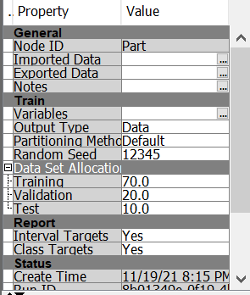
Step 4: Data Partition node:
We attach data partition node to the second statExplore node and in the data partition properties we alter data set allocation percentages for our data set i.e., Training =70; Validation =20; test =10.and run partition mode

Slide 14
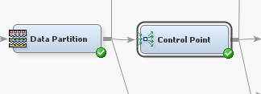
Step 5: Control point node:
Control Point node is used to establish a control point within process flow diagrams. A control point simplifies distributing the
connections between process flow steps that have multiple interconnected nodes. The Control Point node can reduce the number of connections that are made.

Slide 15
Step 6: Model Nodes:
Our main motive for this project is to perform any three models on the data set and find out which model suits best to the data set to predict the target variable values.
The three models we use are:
1. regression.
2.neural network.
3.decision table.

Slide 16
Model 1: Regression:
Regression node:
The purpose of the Regression node is to perform either linear and logistic regression modeling in the process flow.
However, the added capability of the node is that it will allow you to apply the least-squares model in predicting the binary-valued target variable.
We perform four different regression models, all of them are linear regression procedure.

Slide 17
For the AIRBNB dataset we perform four different regression model,
Linear Regression Model :
Linear regression is a linear approach for modelling the relationship between a scalar response and one or more explanatory variables .
Linear predictor functions are used to model the relationships, and the unknown model parameters are estimated from the data.
Stepwise Regression Model:
Stepwise regression is the iterative creation of a regression model wherein the independent variables to be used in the final model are selected step by step. It entails incrementally adding or eliminating potential explanatory factors, with each iteration requiring statistical significance assessment.

Slide 18
Forward Regression Model:
Forward selection is a sort of stepwise regression that starts with a blank model and gradually adds variables. Each time you take a step ahead, you add the one variable that improves your model the most.
Backward Regression Model:
Backward regression is a stepwise regression method that begins with a full model and gradually eliminates variables from the regression model at each step to reach at a reduced model that best explains the data. Backward Regression is also known as Backward Elimination Regression.

Slide 19
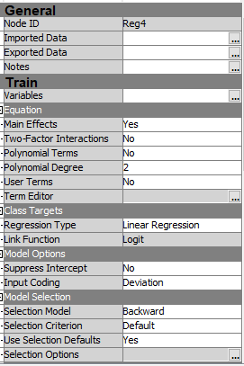
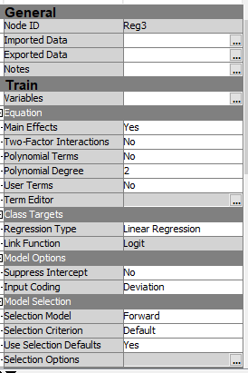
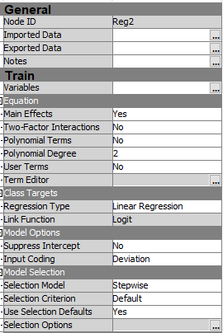
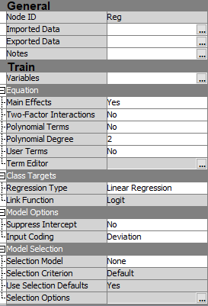
Model Selection for Linear Regression: LINEAR, Stepwise, Forward and Backward.

Slide 20
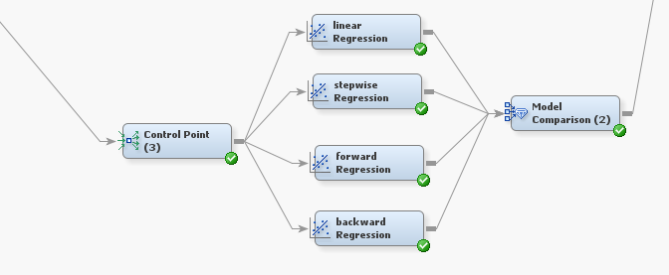
Regression nodes
For changing the type of regressions in nodes, change selection model in properties and run each node separately.

Slide 21
MODEL COMPARISION NODE:
The Model Comparison node belongs to the Assess category in the SAS data mining process of Sample, Explore, Modify, Model, and Assess (SEMMA).
The Model Comparison node enables you to compare the performance of competing models using various benchmarking criteria.
There are many criteria that can be used to compare models.
Comparing model performance depends on the specific application for the model.
The combined criteria enable the analyst to make cross-model comparisons and assessments.
Each node that precedes the Model Comparison node must have a unique name. Even though each node has a unique Node ID, when two nodes with the same name are compared, the results are invalid.

Slide 22
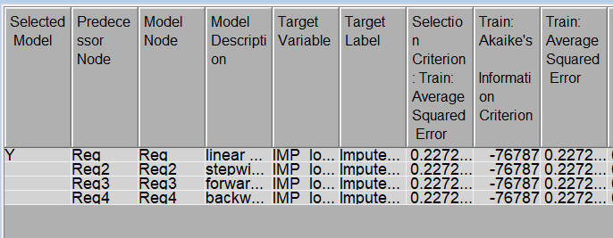
Model Comparison-1:
This node helps to compare all the different models and navigates us to find which model suits best to the data set we choose.
From the result we can decide linear regression model suits best to the dataset.

Slide 23
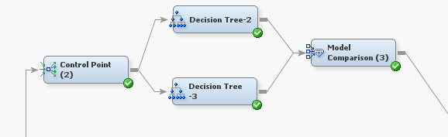
Model 2: Decision Tree:
The Tree node's main function is to do decision tree analysis.
The purpose of decision tree analysis is to do classification or predictive modeling. Based on the input values.
decision tree modeling uses a set of if-then decision rules to create a sequence of partitions that gradually divide the goal values into smaller and smaller homogeneous groups.
We perform two different decision tree nodes one with 2 branches and other with three branches and run each node separately

Slide 24
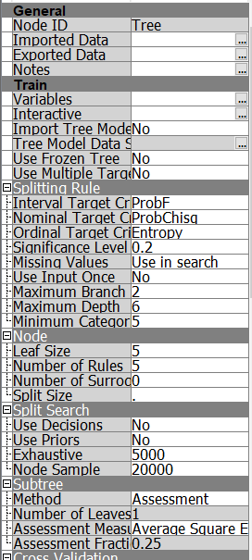
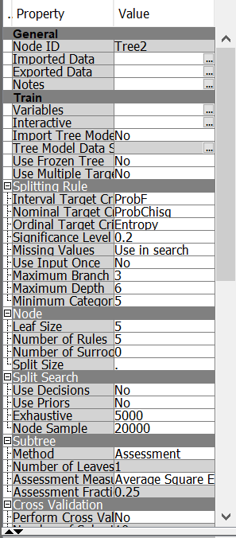
Model Selection for DECISION TREE:

Slide 25
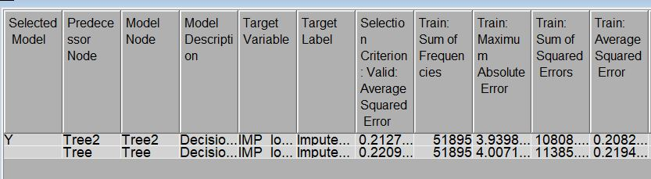
Model Comparison-2:
Attach model comparison to the two decision models and run model comparison node.
From the results, we can see the average squared error for tree 2(0.2082) is less than tree(0.2194). It shows tree2 suits best to the dataset.

Slide 26
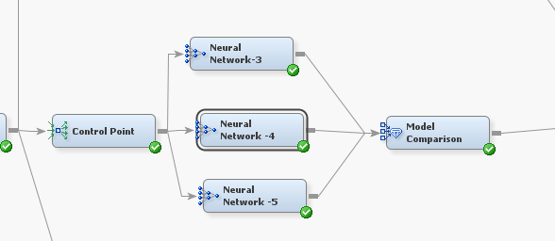
Model 3 : Neural Network Node.
The Neural Network node's function is to perform neural network modeling.
Within the process flow diagram, neural network modeling is essentially non-linear modeling.
The multilayer perceptron MP network is the default neural network architecture, with one hidden layer consisting of three hidden units.
Each input is generally connected to the first layer, each hidden layer is totally connected to the next hidden layer, and the output is fully connected to the hidden layer.
The node is designed to perform MLP and RBF designs, as well as other neural network architectures.
We perform three neural network, to perform different nodes in properties we have to change the number of units in network sector.

Slide 27
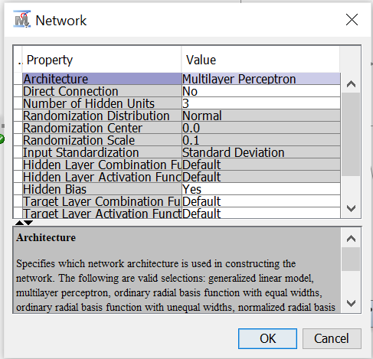
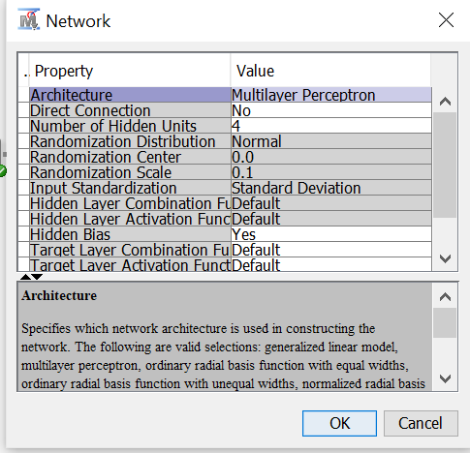
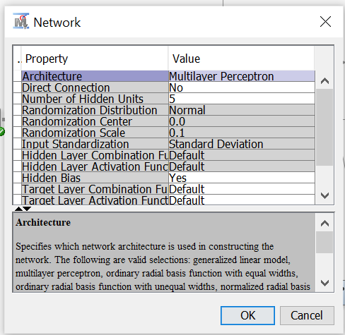
Model Selection for NEURAL NETWORK:

Slide 28
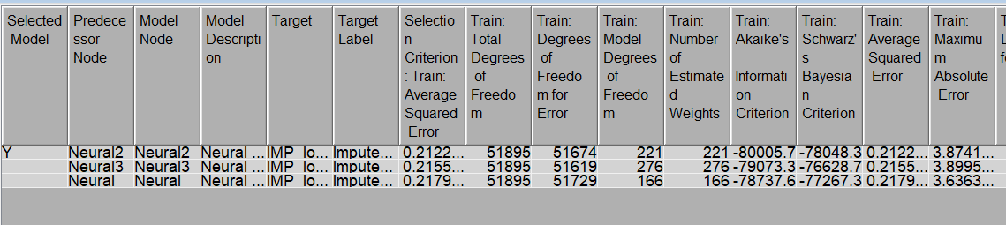
Model Comparison-3:
We perform three neural network, to perform different nodes in properties we should change the number of hidden units in network sector.
For neural1, neural2, neural3 number of hidden units are 3,4,5 respectively.
Run each node separately and attach every network node to model comparison and run model comparison node.
As we can observe, the average squared error for the neural2 has least value and the model comparison states neural2 is the best suitable model for the data set we provided.

Slide 29
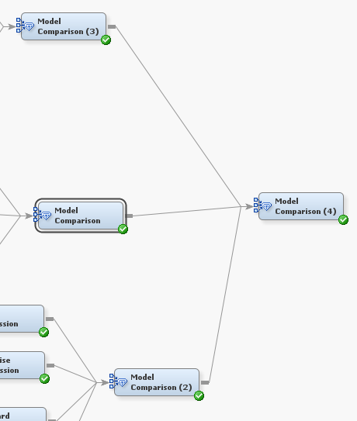
Step 6: Final Model Comparison:

Slide 30
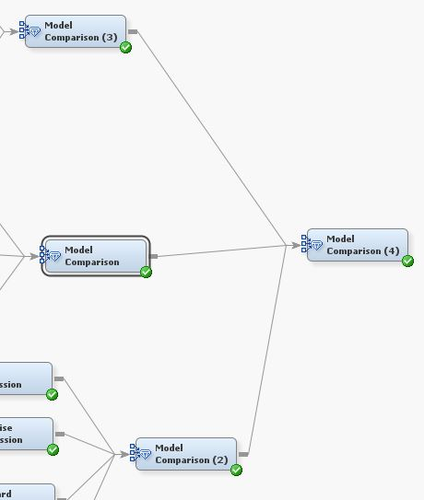
Final model comparison:
We will attach all the three-model comparison to final model comparison, and we run the model comparison node.
From the result, as we can see the average squared error for the decision tree is least compared to the other two models.
So, by the model comparison we can state decision tree with two branches is the best model to predict the target variable values.

Slide 31
OBSERVATIONS FROM THE MODELS:
FROM REGRESSION NODE
Average mean squared for all the four regression models(linear,step-wise, backward, forward) has same value i.e., 0.2272.
FROM NEURAL NETWORK:
Average mean squared for:
Neural network (3) :0.2122
Neural network (4) :0.2155
Neural network (5) :0.2179
FROM DECISION TREE:
Average mean squared for:
Decision tree(2):0.2082
Decision tree(3):0.2192

Slide 32
Business implications:
From the model implication-1 results we can observe that all the parameter values are same for all the types of regressions(linear, stepwise, backward, forward), so regression modeling is not best model for the AIRBNB data set.
From the model implication-2 results we can observe that average squared error for tree 2(0.2082) is less than tree(0.2194). It shows tree2 suits best to the dataset.
From the model impilication-3 results we can observe that average squared error for the neural2 has least value and the model comparison states neural2 is the best suitable model for the data set we provided.

Slide 33
CONCLUSION:
From the final model comparison, we can state that the decision tree(3) is the best model for the AIRBNB data set. The average square error of decision tree(3) is 0.2084.
Compared to the other models the decision tree with 3 branches suits best to the AIRBNB data set with 29 variables and log_price as target value.

